Slide 1

SENTIMENTAL TWITTER ANALYSIS
CVR COLLEGE OF ENGINEERING
DEPARTMENT OF COMPUTER SCIENCE AND ENGINEERING
(AN UGC AUTONOMOUS INSTITUTION)
Mini project Review
Project guide-
Mrs. G. Swetha
Sr.Asst. Professor CSE dept.
Team members-
G. Pavan Chaitanya (20B81A05F4)
P. Priskilla (20B81A05F7)

Slide 2

Introduction
Sentiment Analysis-
Sentiment analysis (also known as opinion mining) is contextual mining of text which identifies and extracts subjective information in source material, and helping a business to understand the social sentiment of their brand, product or service while monitoring online conversations.

Slide 3
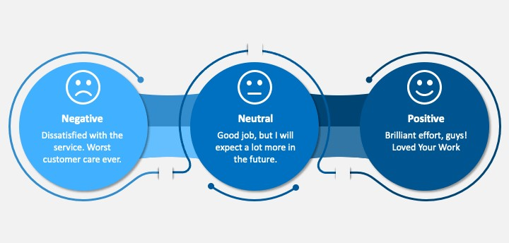
SENTIMENTAL ANALYSIS is the most common text classification tool that analyses an incoming message and tells whether the underlying sentiment is positive, negative or neutral.

Slide 4
ABSTRACT-
This project addresses the problem of sentiment analysis in twitter; that is classifying tweets according to the sentiment expressed in them: positive, negative or neutral. Twitter is an online micro-blogging and social-networking platform which allows users to write short status updates of maximum length 280 characters. It is a rapidly expanding service with over 200 million registered users - out of which 100 million are active users and half of them log on twitter on a daily basis - generating nearly 250 million tweets per day. Due to this large amount of usage we hope to achieve a reflection of public sentiment by analysing the sentiments expressed in the tweets. Analysing the public sentiment is important for many applications such as firms trying to find out the response of their products in the market, predicting political elections and predicting socioeconomic phenomena like stock exchange. The aim of this project is to develop a functional classifier for accurate and automatic sentiment classification of an unknown tweet stream.

Slide 5
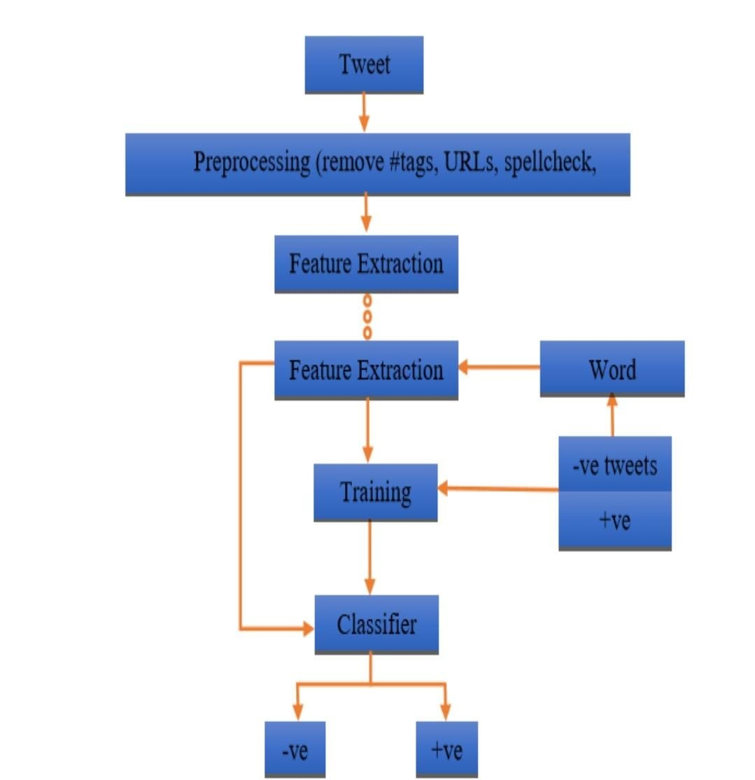
Architecture-

Slide 6
Modules-
NLP(Deep learning):NLP in deep learning is a technique that uses neural networks to process human language. It's more accurate than traditional methods.
The approach involved in this project are the various data pre-processing steps, the machine learning classifiers and feature extraction. The main data pre-processing steps include URL and username filtering, twitter slang removal, stop words removal and stemming.
The machine learning algorithms used are Multinomial Naive Bayes, Support vector machine and Logistic Regression. That helped in getting higher accuracy for the dataset.

Slide 7
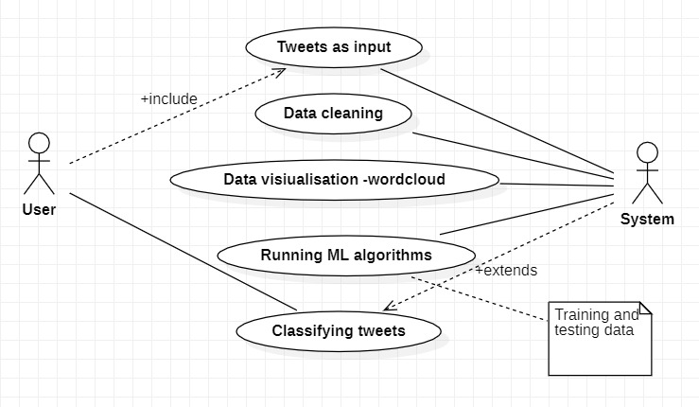
UML Diagrams Use case diagram-

Slide 8
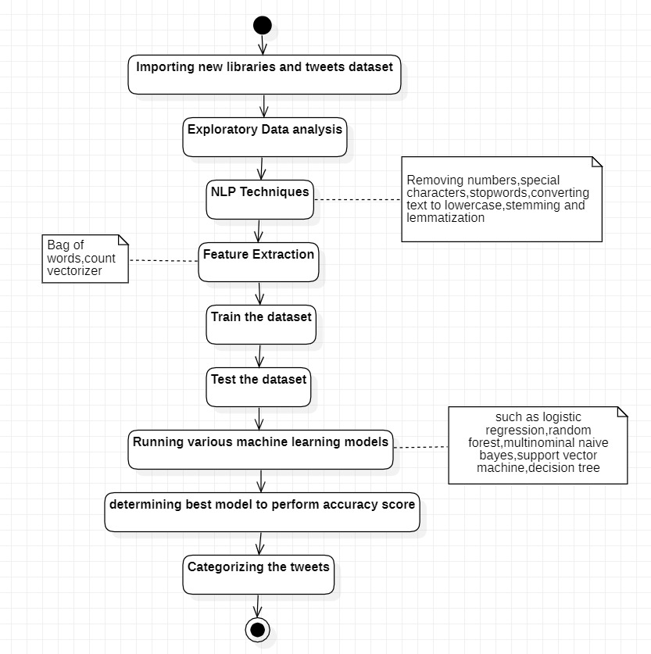
Activity diagram-

Slide 9
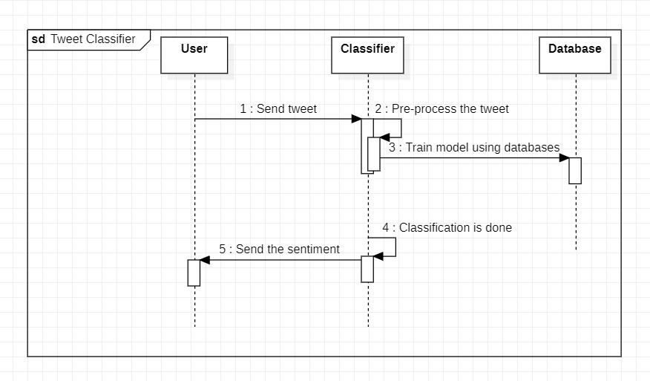
Sequence diagram-

Slide 10

Requirements-
Hardware SPECIFICATIONS:-
Software Requirements:-
Processor: Intel i2 or more
Motherboard: Intel Chipset Motherboard
RAM: 8GB or more
Cache: 512 KB
Hard Disk: 16 GB hard disk recommended
Disk Drive:1.44MB Floppy Disk Drive
Monitor:1024 x 720 Display
Speed: 2.7GHZ and more
Operating System: Windows 7/8/8.1/10/11 or any OS with greater throughput.
Python
Jupyter(Text Editor)
Microsoft PowerPoint (2016)

Slide 11
Existing codes-
Anupama B, Rakshith D and Rahul Kumar (Students at International Journal of Engineering Research & Technology) have done some serious work in twitter sentiment analysis.
Even though their source code is not publicly available, their approach was to use machine learning algorithm to analyse real time twitter data.
Disadvantages-
To use a real time data, one must have an existing twitter account and must deal with several twitter API keys and authenticate himself, which increases the complexity for the user.
Using Real time data limits the user to analyse only 1000 tweets, doing which is a very small number when companies try to analyse large set of data.

Slide 12
Proposed System-
We have used a dataset containing over 16 lakh tweets and analysed them in a 6 step approach.
Step 1: Data Collection.
Step 2: Data Cleaning.
Step 3: Data Visualization.
Step 4: Making Training and Testing Data.
Step 5: Model Evaluation.
Step 6: Model Building.
However, this alone does not make it an easy task (in terms of programming time, not in accuracy as larger piece of text tends to be correctly classified) as people rarely give a second thought before posting a tweet. Grammar and content both suffer at the hands of the tweeter.
Advantages-
The data set used by us is however public and we have used the same data set in order to obtain results with greater accuracy in the classification of tweets’ sentiments, that made our work of some insightful approaches.

Slide 13
FUTURE WORK-
For the future work on sentiment analysis, it is necessary to perform real time sentiment polarity assigning to the Twitter data. To do so, by preparing an outline to implement same data processing algorithm on cloud that increase the performance for sentiment analysis using Natural Language Processing (NLP) techniques. This can be done by creating nodes on cloud data platform like Hadoop that allow us to store the data on cloud using HDFS (Hadoop File System) and Map-reduce concept to distribute the data processing algorithm on cloud to load and process large size data set and real time sentiment analysis for the linguistic data. This will be contribution towards real time sentiment analysis in a cloud environment and will allow the business user to fetch real time sentiment analysis for the linguistic data.

Slide 14

Thank you
20B81A05F4
20B81A05F7

